Slide 1
Šifrované USB disky
Jakub Mazal
COMGUARD a.s.

Slide 2
Cesty k Data loss prevention a jejich cena
Encryption
Training
Endpoint Security
Manual controls
Asset management
Data loss prevention
Notes:
Ponemum Instistute, 2015. Table 1: Data Loss prevention controls and activities.

Slide 3
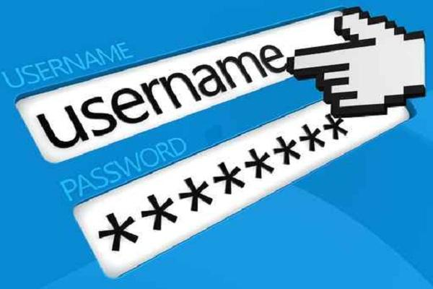
Šifrování - cesta jak nejlevněji zabezpečit data
Šifrování zabezpečují vhodná opatření, která zajistí důvěrnost a bezpečnost přenášených dat.
Vyžadováno heslo k přístupu k datům.
Byl USB disk chránený?
?
Notes:
About half of data breaches are malicious, so IT departments can encrypt data at every point of entry protect the personal data that they collect and store.

Slide 4
Šifrování digitálních médií chrání data v pohybu
Zhruba polovina úniků dat jsou způsobena interně, což může být ochráněno preventivním školením a dodržováním politik.
Zaměstnanec přistupuje k citlivým datům
Data
Policy
Encrypted USB
Endpoint
Security
Training
Productive
employees
Zaměstnanci mají přístup k datům i na cestách
Data jsou chráněna šifrováním
USB disk je jednoduchá na používání a nepotřebuje složitá školení
Kontrola periferií koncového stroje

Slide 5
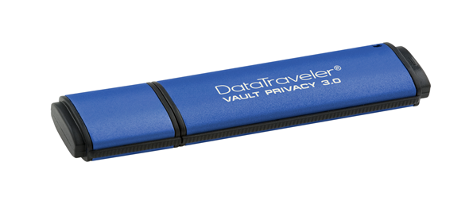
Možnosti politiky, které by měly organizace zvážit
Zakázat USB Porty
+ Ultimate Security
+ Splněny normy
- Omezení flexibility
- Náklady na jiné způsoby bezpečného přesunu dat
Vynutit šifrování
+ Flexibilita
+ Data jsou zabezpečena
+ Splněny normy
- Investice do Hardware
Notes:
Locking down USB ports also prevent use of other USB peripherals: keyboard, mouse, phone charging, etc
VPN

Slide 6
Šifrovaná USB jsou kompatibilní s endpoint security
Prostřednictvím správy koncových bodů mohou společnosti povolit pouze schválená USB zařízení, aby zajistily, že uživatelé budou vždy využívat šifrování.
White List
Vendor ID
Product ID
Serial Numbers

Slide 7
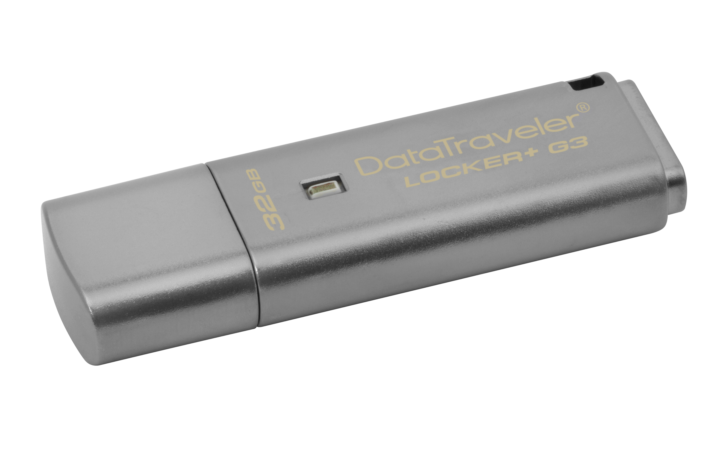
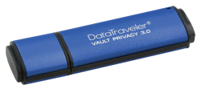
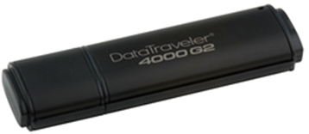
Encrypted DataTraveler Line-Up
Locker+ G3
Vault Privacy 3.0
2000
4000G2
USB 3.0 | Locker+ G3 | Vault Privacy 3.0 | 2000 | 4000G2
Encryption | Hardware Encryption | AES 256-Bit Hardware Encryption | AES 256-Bit Hardware Encryption | AES 256-Bit Hardware Encryption
Feature | USBtoCloud™ Software | XTS Block Cipher Mode | OS independent | XTS Block Cipher Mode
FIPS | n/a | FIPS 197 | FIPS 197 | FIPS 140-2 Level 3
Capacities | 8GB-64GB | 4GB-64GB | 16GB-64GB | 4GB-64GB
Anti-Virus | Available through USBtoCloud™ | Anti-Virus SKUs Available | n/a | n/a

Slide 8
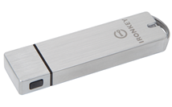
Encrypted IronKey Line-Up
D300
S1000
 | D300 | S1000
Encryption | AES 256-Bit Hardware Encryption | AES 256-Bit Hardware Encryption
Feature | IronKey EMS support XTS Block Cipher Mode | IronKey EMS support XTS, CryptoChip
FIPS | FIPS 140-2 Level 3 | FIPS 140-2 Level 3
Capacities | 4GB-128GB | 4GB-128GB

Slide 9
DT Locker+G3: Snadná ochrana citlivých dat
Hardware encryption – the best in personal security to keep data safe.
Easy-to-use – no application installation
Superior password protection
Complex password
Locks after 10 attempts
Now with USBtoCloud Software, featuring file backup to Google Drive, Amazon S3, Microsoft OneDrive, Dropbox, Box, OneDrive for Business or ShareFile.
Anti-Virus available through USBtoCloud™
Durable Metal casing
USB 3.0, compatible with USB 2.0
Works interchangeably with Mac and Windows systems**
5 Year Warranty
8 - 64GB capacities
Customizable co-logo program
USB 3.0 | Read* | Write*
8GB | 80MB/s | 10MB/s
16GB | 135MB/s | 20MB/s
32GB | 135MB/s | 40MB/s
64GB | 135MB/s | 40MB/s
*Based on Internal Testing
** USBtoCloud works with Windows only
9

Slide 10
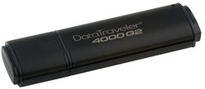
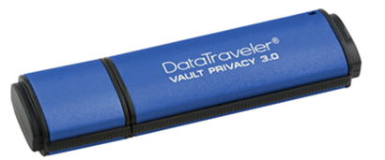
Common Features for the DT4000G2 & DTVP30
FIPS 140-2 Level 3
FIPS 197
100% 256-bit AES hardware based encryption in XTS block cipher mode.
Lockout after 10 incorrect password entries wiping keys and formatting the drive.
Enforced complex password with minimum password length.
Hardware based authentication
Digitally Signed Firmware
Wear-leveling: Under extreme drive usage (writing 80% drive capacity each and every day) drive endurance would exceed 10 years of use!
TAA Compliant
5 Year warranty with free global technical support
Rugged, waterproof metal casing
Customizable drives and features available including dual password, serialization, co-logo, custom profiles, custom password requirements, and more.
Notes:
*Password complexity: 3 of the following 4: upper-case letter, lower-case letter, number, special character:!@#$%...

Slide 11
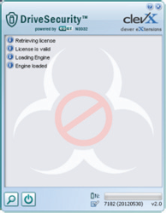
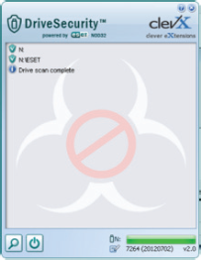
DataTraveler Vault Privacy 3.0 with ESET Anti-Virus
NOD 32® AV Engine provided by ESET
Powerful antivirus utility that prevents viruses, Trojans and other malware from spreading via USB.
Easy to deploy, factory pre-activated solution
Automatically loads when user successfully authenticates the drive
System tray icon notifies users of threat
USB 3.0, backwards compatible with USB 2.0
4GB – 64GB capacities
ESET: Windows (XP, Vista, 7, 8) compatible
Part Number: DTVP30AV/xxGB

Slide 12
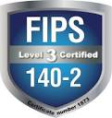
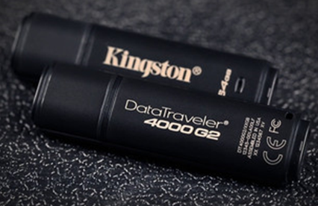
DataTraveler 4000G2: FIPS 140-2 Level 3
100% hardware encryption
256-bit AES Hardware encryption
XTS block cipher mode
FIPS 140-2 Level 3 Validated
Certificate #2307
USB 3.0, backwards compatible with USB 2.0
Locks and reformats after 10 intrusion attempts
Enforced complex password
User selectable read only mode
Protection against spreading viruses
Rugged waterproof metal casing
Windows, Mac & Linux OS support
Customization and Co-Logo program
5 Year Warranty
4 - 64GB capacities
Management ready SKU : DT4000G2DM
DT4000G2 will phase out in Q3 as FIPS drives moves to Ironkey
USB 3.0 | Read* | Write*
4GB | 80MB/s | 12MB/s
8GB | 165MB/s | 22MB/s
16GB | 165MB/s | 22MB/s
32GB | 250MB/s | 40MB/s
64GB | 250MB/s | 85MB/s
* USB 2.0 speeds: 30MB/s read, 20MB/s write (4GB: 30MB/s read, 12MB/s write)

Slide 13
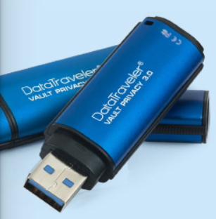
Vault Privacy 3.0: Strong Security for Enterprise
100% hardware encryption
256-bit AES Hardware encryption
XTS block cipher mode
Locks and reformats after 10 intrusion attempts
Enforced complex password
User selectable read only mode
Protection against spreading viruses
FIPS-197
USB 3.0, backwards compatible with USB 2.0
Rugged waterproof metal casing
Windows, Mac & Linux OS support
Customization and Co-Logo program
5 Year Warranty
4 - 64GB capacities
Anti-Virus SKU : DTVP30AV
Management Ready SKU : DTVP30DM
USB 3.0 | Read* | Write*
4GB | 80MB/s | 12MB/s
8GB | 165MB/s | 22MB/s
16GB | 165MB/s | 22MB/s
32GB | 250MB/s | 40MB/s
64GB | 250MB/s | 85MB/s
* USB 2.0 speeds: 30MB/s read, 20MB/s write (4GB: 30MB/s read, 12MB/s write)

Slide 14
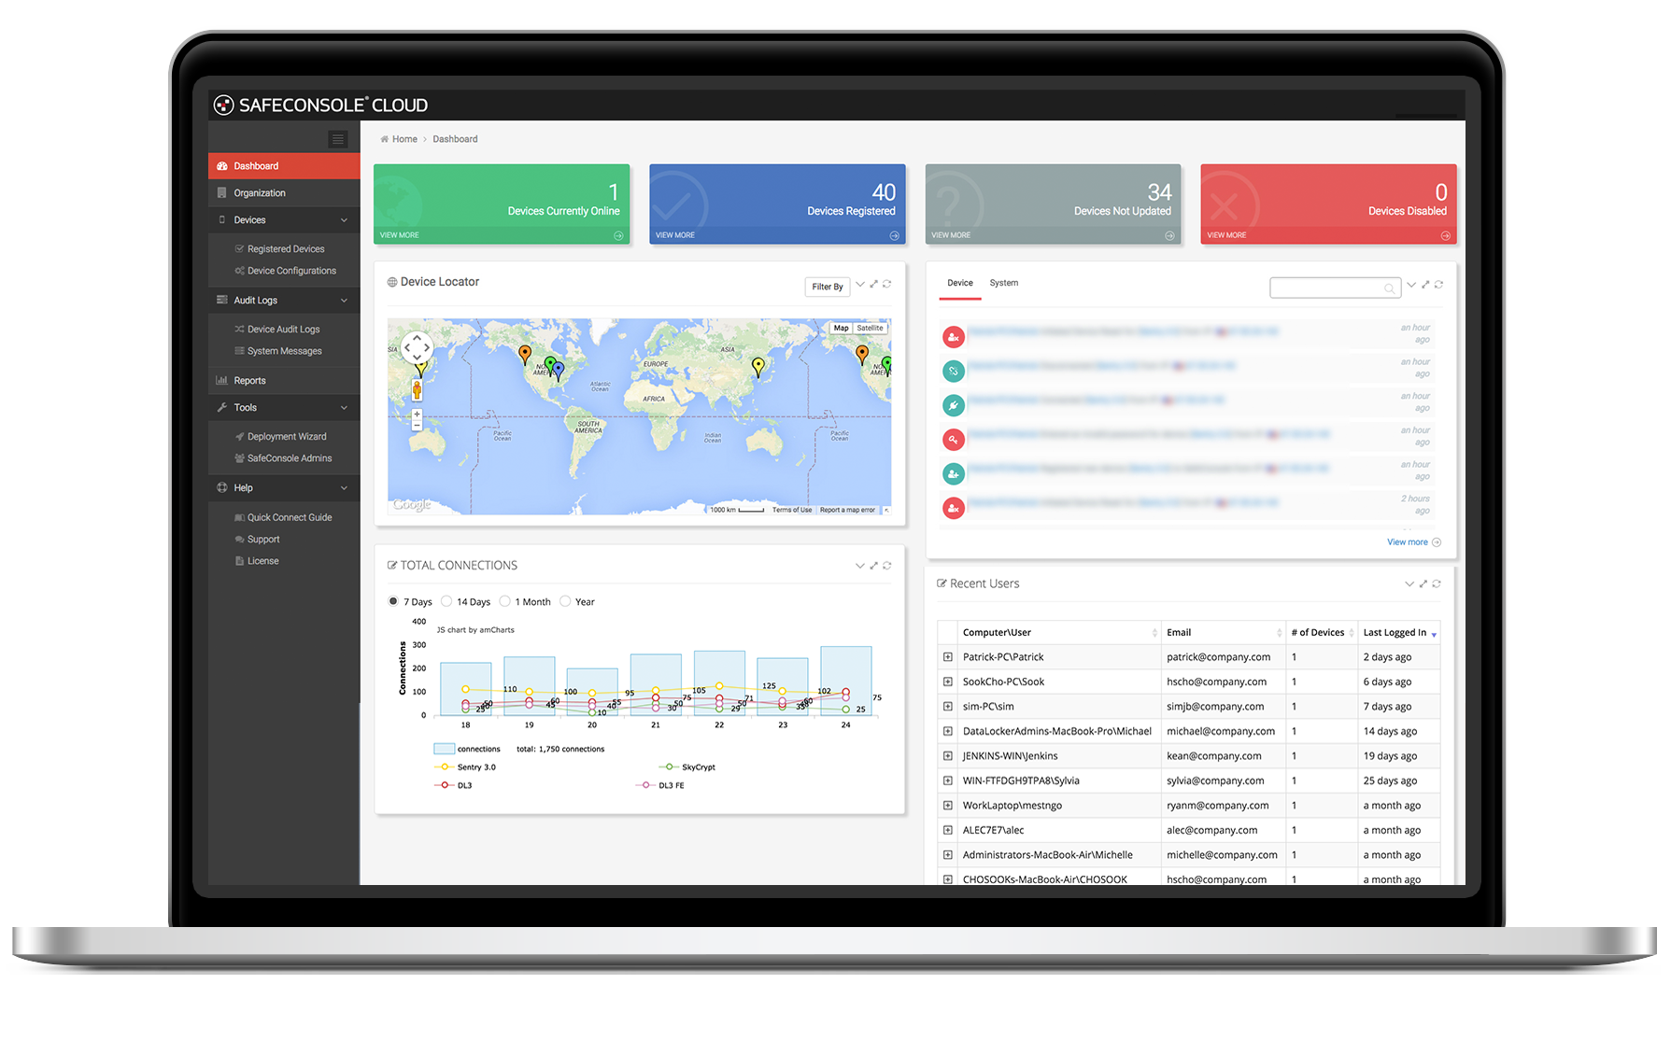
SafeConsole Management Software
Secure USB Management allows an organization to quickly and easily establish a command center to inventory, audit and control their secure USB storage devices.
Remote Password Reset
Password Policy
Device Audit
Device State Management
Geolocation and Geofencing
Kingston management ready SKUs support the latest SafeConsole Management software from DataLocker.
The drives can function without the use of SafeConsole helping purchasing decisions.

Slide 15
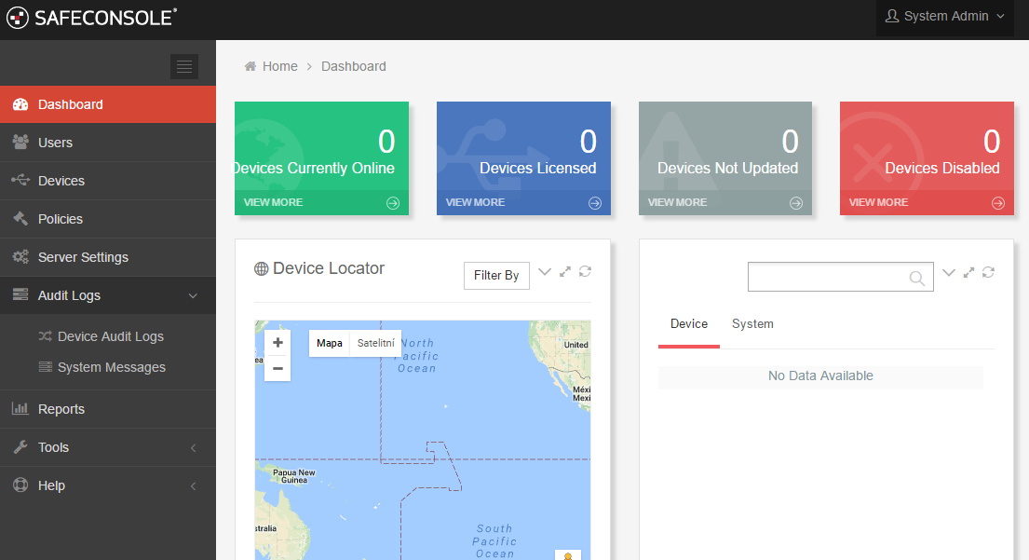
SafeConsole Management Software

Slide 16
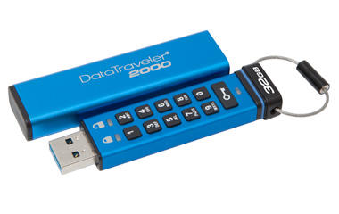
DataTraveler 2000: Keypad Drive
100% hardware encryption
256-bit AES Hardware encryption
XTS block cipher mode
OS independent
Locks and reformats after 10 intrusion attempts
Auto-Lock feature, when the drive is removed from a device
User selectable read only mode
Protection against spreading viruses
FIPS-197 Certified
USB 3.0, backwards compatible with USB 2.0
Rugged waterproof metal casing
16 - 64GB capacities
USB 3.0 | Read* | Write*
16GB | 120MB/s | 20MB/s
32GB | 135MB/s | 40MB/s
64GB | 135MB/s | 40MB/s
* USB 2.0 speeds: 30MB/s read, 20MB/s write
Notes:
Android OS is used on the majority of devices

Slide 17
IronKey

Slide 18
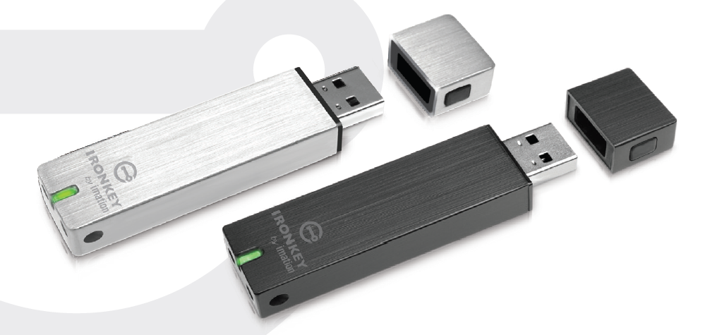
IronKey S250, D250
100% hardware encryption
256-bit AES Hardware encryption
CBC mode
FIPS 140-2 Level 3 Validated
Certificate #2018
USB 2.0
S250 – SLC Nand, Up to 31MB/sec read; 24MB/sec write
D250 – MLC Nand, Up to 29MB/sec read; 13MB/sec write
After 10 failed attempts the drive can self-destruct or reset, depending on user selection
User selectable read only mode
Protection against spreading viruses
Rugged waterproof Metal casing
Windows, Mac & Linux OS support
5 Year Warranty
2 - 64GB capacities
Available in Basic and Enterprise SKUs
Capacity | Basic S250 | Enterprise S250 | Basic D250 | Enterprise D250
2GB | IKS250B/2GB | IKS250E/2GB | IKD250B/2GB | IKD250E/2GB
4GB | IKS250B/4GB | IKS250E/4GB | IKD250B/4GB | IKD250E/4GB
8GB | IKS250B/8GB | IKS250E/8GB | IKD250B/8GB | IKD250E/8GB
16GB | IKS250B/16GB | IKS250E/16GB | IKD250B/16GB | IKD250E/16GB
32GB | IKS250B/32GB | IKS250E/32GB | IKD250B/32GB | IKD250E/32GB
64GB | n/a | n/a | IKD250B/64GB | IKD250E/64GB

Slide 19
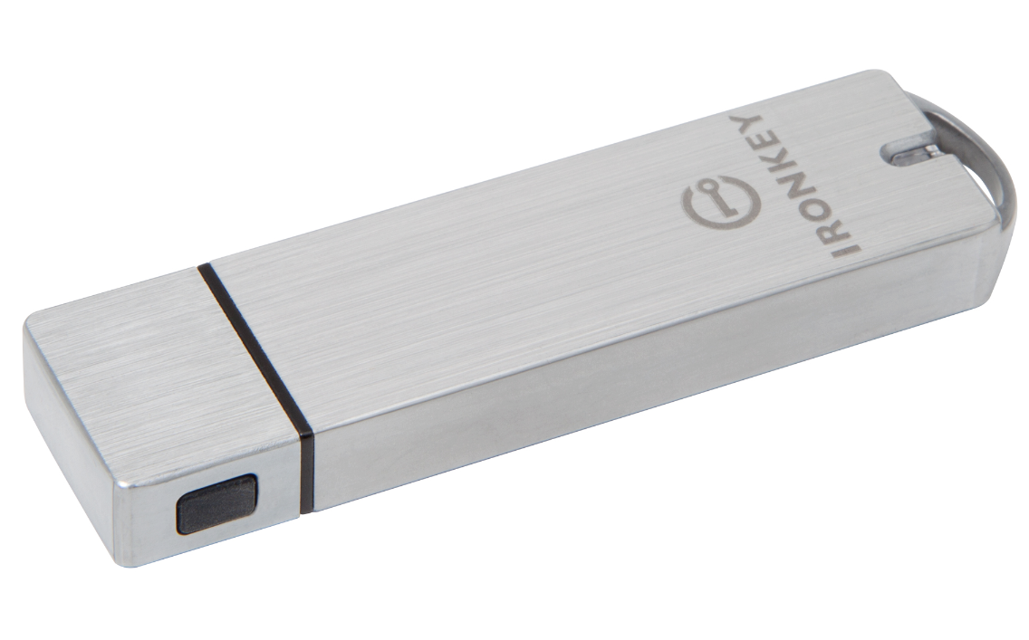
IronKey S1000
100% hardware encryption
256-bit AES Hardware encryption
XTS block cipher mode
FIPS 140-2 Level 3 Validated
Certificate #2320
USB 3.0, backwards compatible with USB 2.0
After 10 failed attempts the drive can self-destruct or reset, depending on user selection
User selectable read only mode
Protection against spreading viruses
Rugged waterproof Anodized Aluminum casing
Windows, Mac & Linux OS support
5 Year Warranty
4 - 128GB capacities
Max Read: 400 MB/second; Max Write: 300 MB/second
Available in Basic and Enterprise SKUs
Capacity | Basic S1000 | Enterprise S1000
4GB | IKS1000B/4GB | IKS1000E/4GB
8GB | IKS1000B/8GB | IKS1000E/8GB
16GB | IKS1000B/16GB | IKS1000E/16GB
32GB | IKS1000B/32GB | IKS1000E/32GB
64GB | IKS1000B/64GB | IKS1000E/64GB
128GB | IKS1000B/128GB | IKS1000E/128GB

Slide 20
IronKey D300
100% hardware encryption
256-bit AES Hardware encryption
XTS block cipher mode
FIPS 140-2 Level 3 Validated (certificate 2731)
Durable, waterproof metal casing with additional Epoxy to provide the strongest physical protection.
Locks and reformats after 10 intrusion attempts
Enforced complex password
Digitally Signed Firmware (Immune to BadUSB)
USB 3.0/2.0; Windows, Mac & Linux OS support
Customization and Co-Logo program
4 - 128GB capacities, 5 Year Warranty
Forced Management SKU : IKD300M
launching late-Sept
Requires IronKey EMS license (sold by DataLocker)
USB 3.0 | Read* | Write*
4GB | 80MB/s | 12MB/s
8GB | 165MB/s | 22MB/s
16GB | 165MB/s | 22MB/s
32GB | 250MB/s | 40MB/s
64GB | 250MB/s | 85MB/s
128GB | 250MB/s | 85MB/s
* USB 2.0 speeds: 30MB/s read, 20MB/s write (4GB: 30MB/s read, 12MB/s write)
Notes:
The D300 will replace the IronKey x250 and DT4000G2
Federal Information Processing Standards

Slide 21
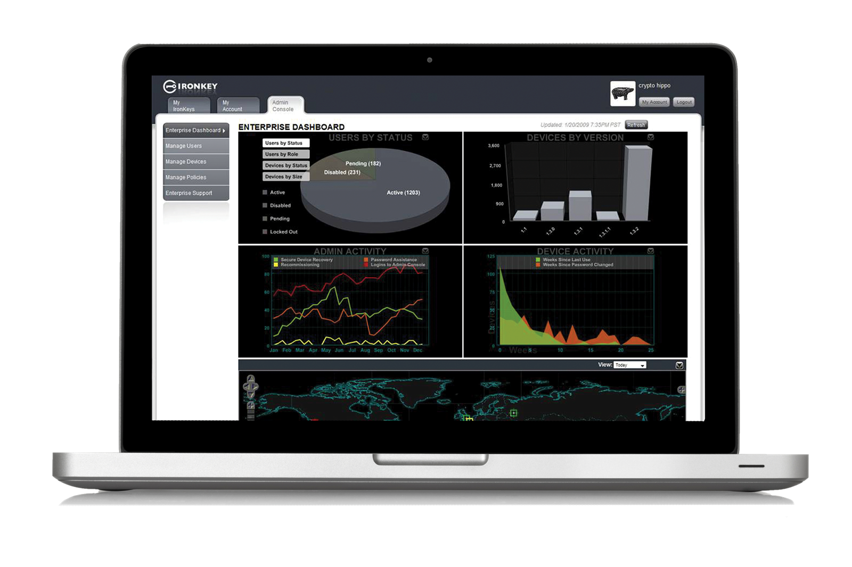
Basic and Enterprise Drives
Basic
Stand alone drives.
Secure Backup
Self-destruct or reset (if previously enabled) after 10 failed consecutive password attempts
Basic S1000 drives can be upgraded to Enterprise drives.
Non-Managed
Enterprise
Must also purchase Enterprise Management Service (EMS) from DataLocker.
An Advanced Platform for the Secure Enterprise that quickly and easily allows you protect data by administering usage and encryption policies, password restrictions, and more from a central console.
Monitor Ironkey Entreprise drives in the field with a powerful, flexible asset tracking system.
Fast, Flexible Deployment
Create a Virtual Command Center
Leverage Existing Virtualization Platform
Ensure Compromised Drives Don’t Compromise Data
Forced Managed

Slide 22
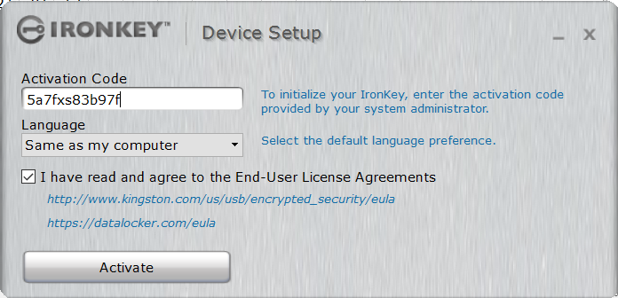
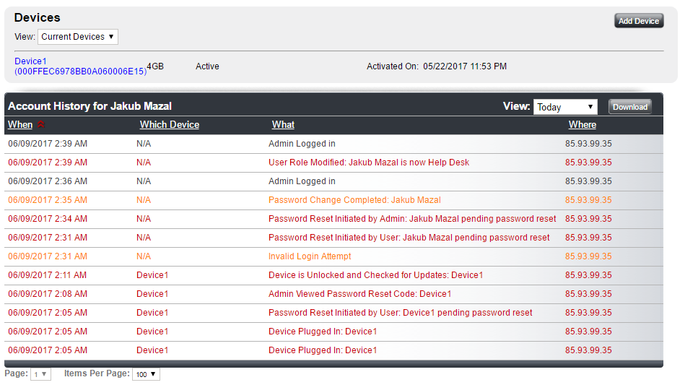
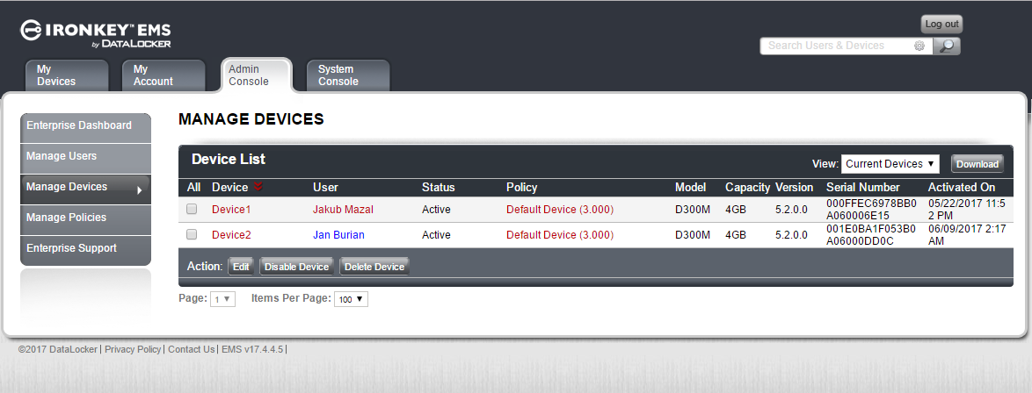
Ironkey EMS

Slide 23
Děkuji za pozornost
Jakub Mazal| jakub.mazal@comguard.cz | www.comguard.cz
Dotazy?
@comguard_ict

